Slide 1
Employment and Guardianship
David H. Ingram
I/DD Employment Specialist
September 22, 2017

Slide 2
John-E’s Skills and ‘Needs’
SOURCE: Dale Dileo’s Raymond’s Room

Slide 3
I/DD Employment Information
SOURCE: NCI 2015-2016

Slide 4
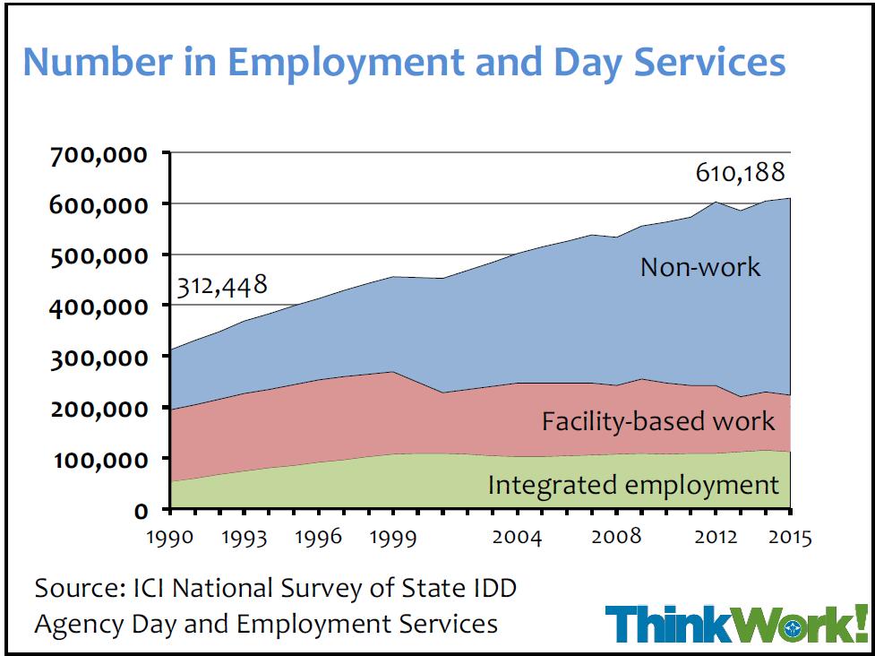
National Trends
SOURCE: ThinkWork!

Slide 5
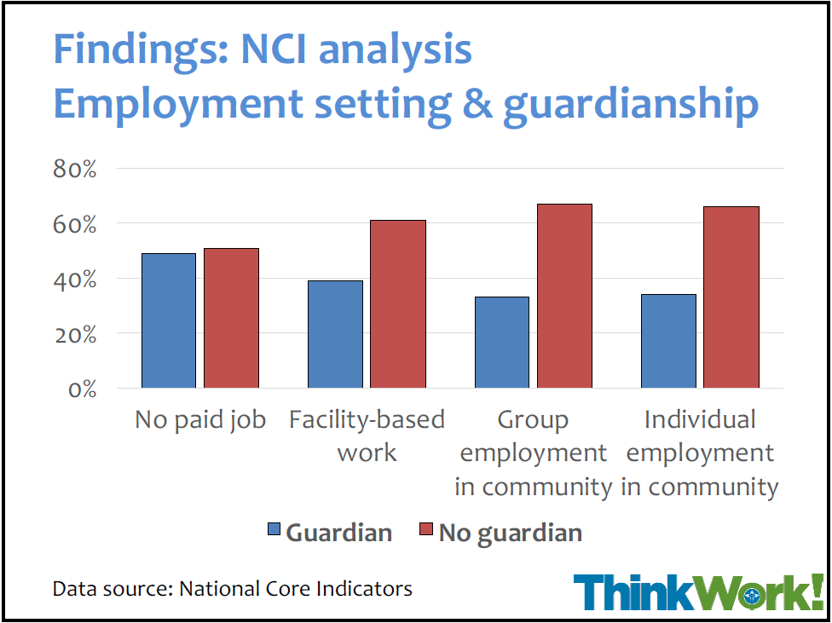
Guardianship and Employment Statistics
SOURCE: ThinkWork!

Slide 6
Jane-E’s ‘Favorite Food’

Slide 7
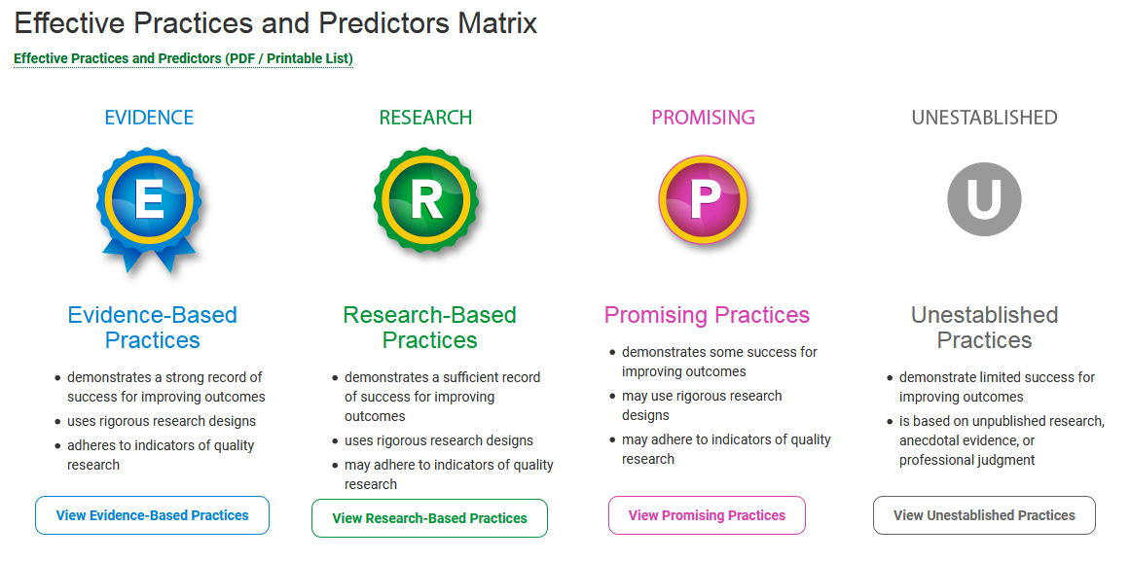
Informational Resources
SOURCE: NTACT

Slide 8
Work Incentives

Slide 9
Employment Resources

Slide 10
Questions & Answers

Slide 11
Contact Information
David Ingram
David.Ingram@dhhs.nc.gov
919.743.2114

