Slide 1
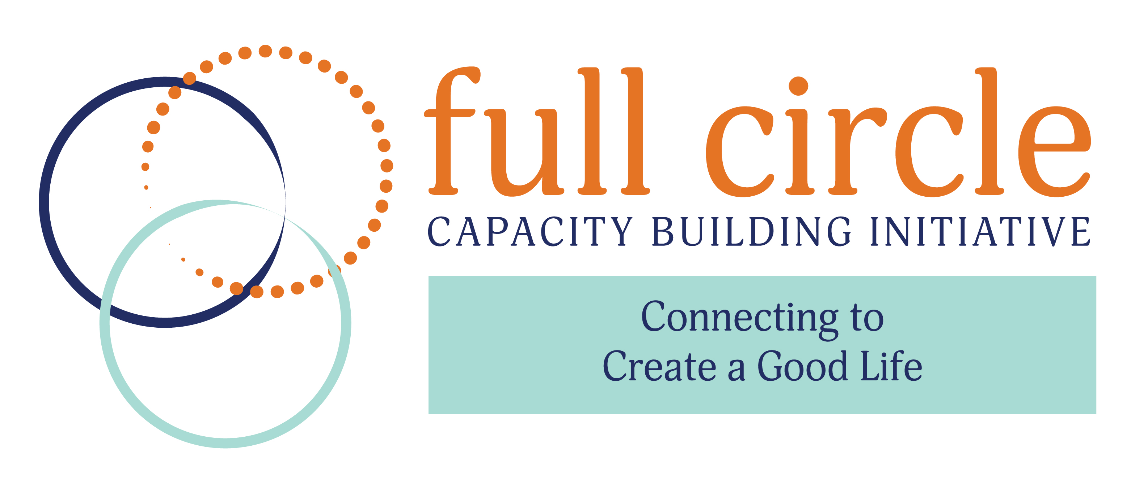

Slide 2
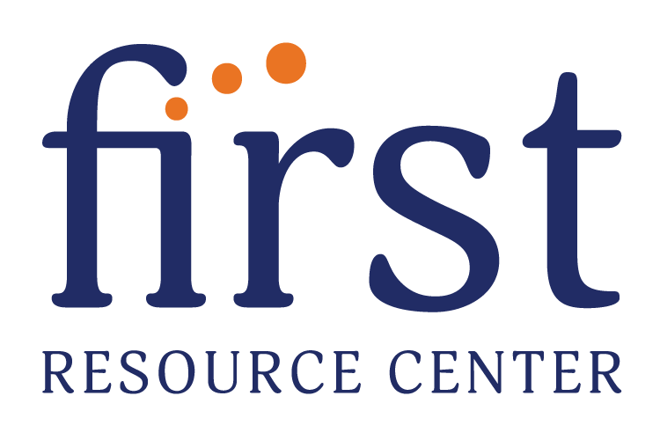

Collaborative Project

Slide 3
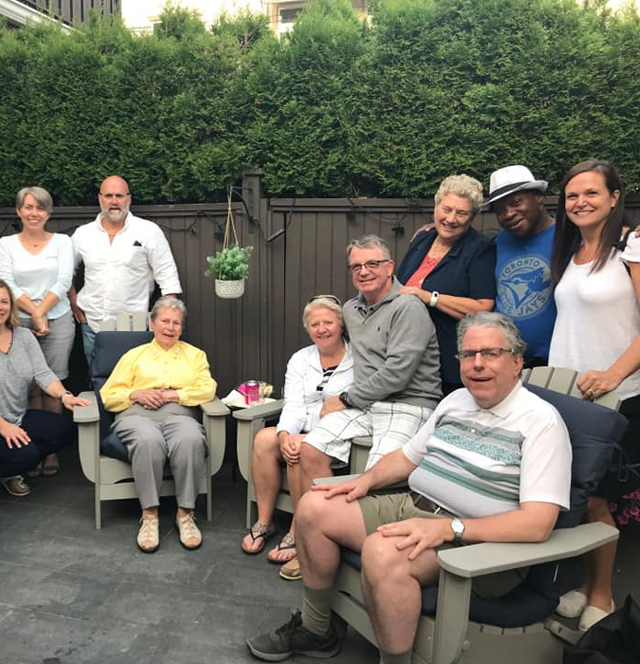
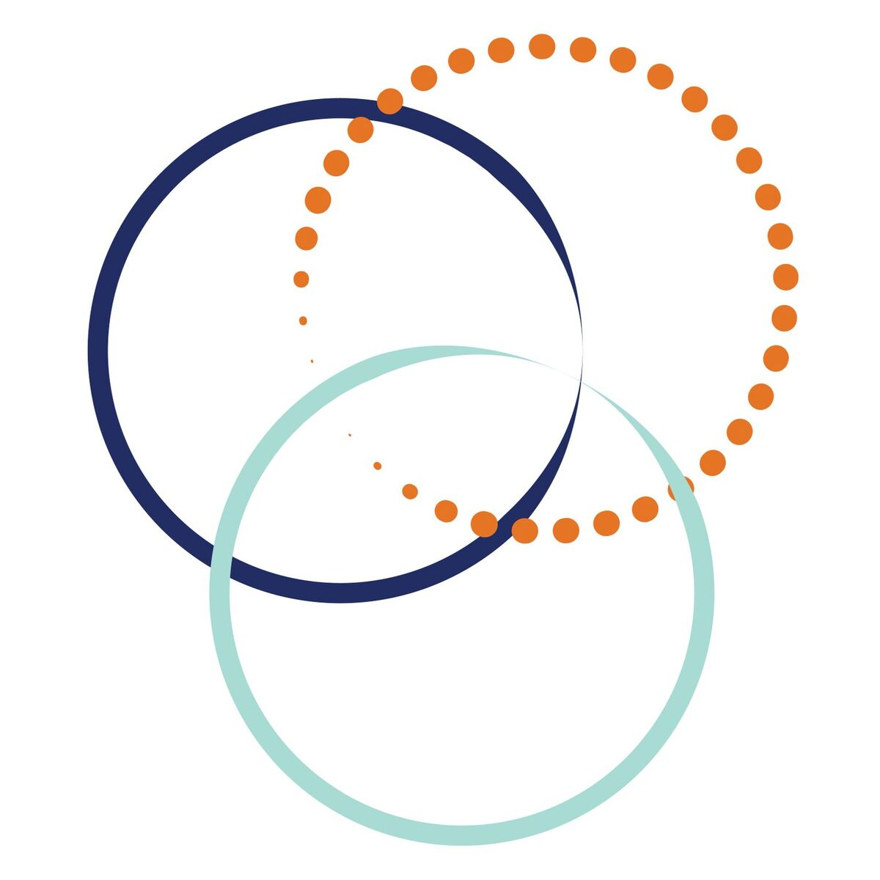
Full Circle is a capacity-building initiative designed to mobilize personal networks for people with disabilities.
Full Circle helps people to expand their circles of connection and natural support in their communities, giving them more opportunities for meaningful and supportive relationships, more experiences, an overall sense of belonging and a good, happy life.

Slide 4
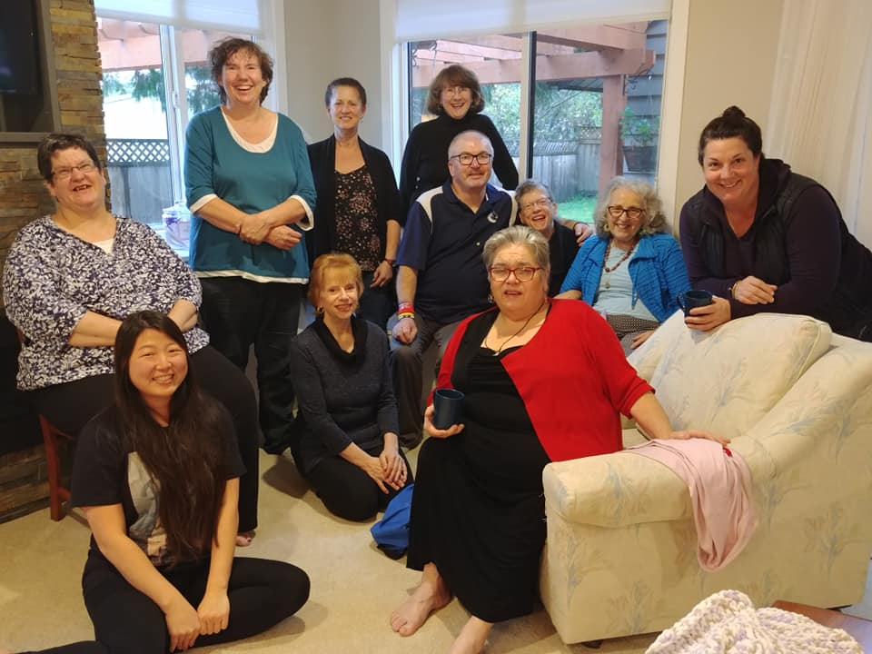
The Full Circle Program is an opportunity for people with disabilities, and their families and caregivers to learn more about the values, principles, practices and tools that they will use to build and nurture Personal Support Networks.

Slide 5

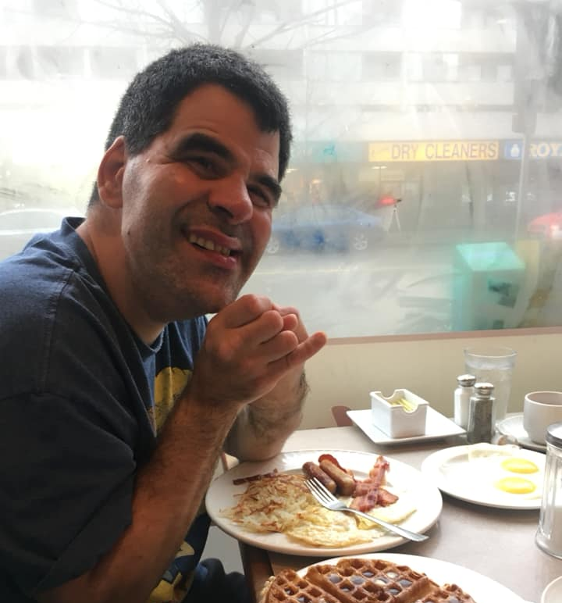
Full Circle’s program helps people with disabilities develop a Personal Network, which can do many things and serve many roles based on what the individual wants and needs, such as:
● Providing a sense of security and support for family members
● Providing links to others in the community
● Spending social time together
● Dreaming and planning together
● Securing and monitoring supports and services
● Assisting with finding homes and roommates
● Providing a forum for Network members to support one another

Slide 6
Full Circle will create a growing, scalable network of small teams that will help champion and implement their program, bringing happiness and more opportunities to people with disabilities throughout their communities.

Slide 7

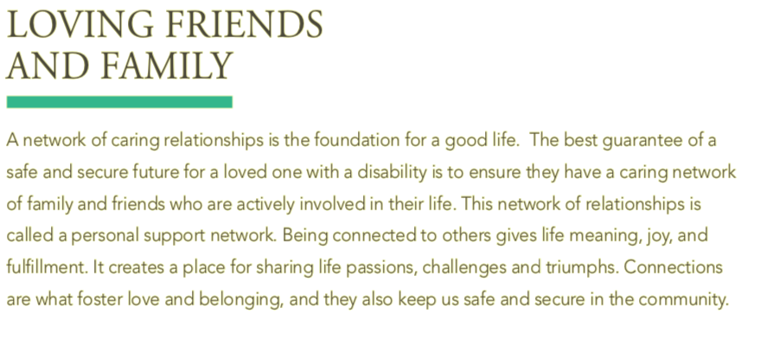

Slide 8
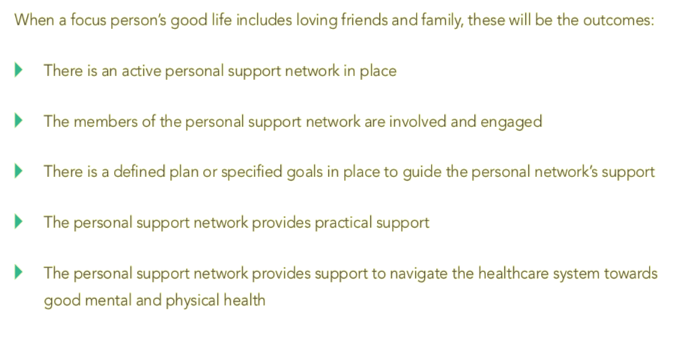

Slide 9
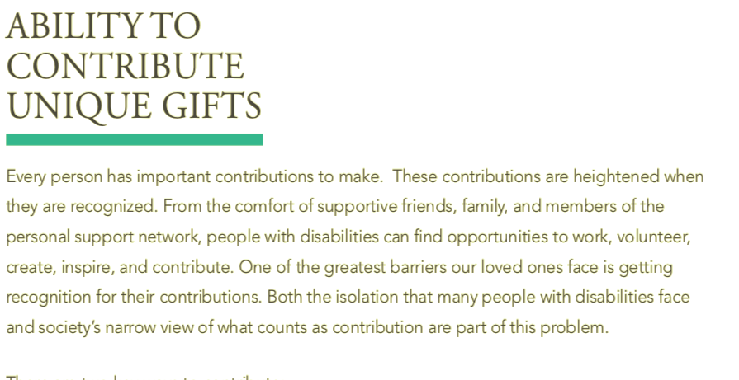

Slide 10
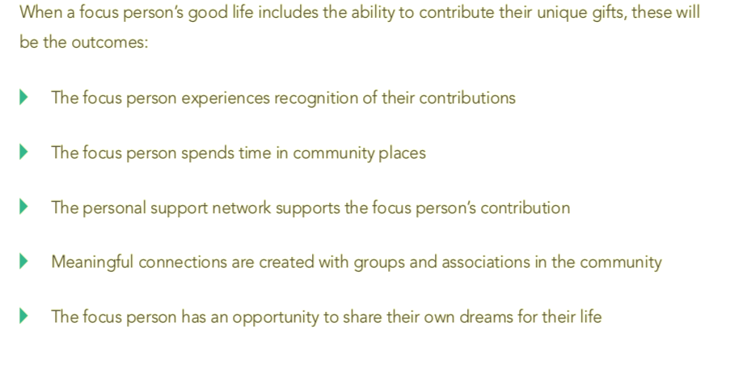

Slide 11
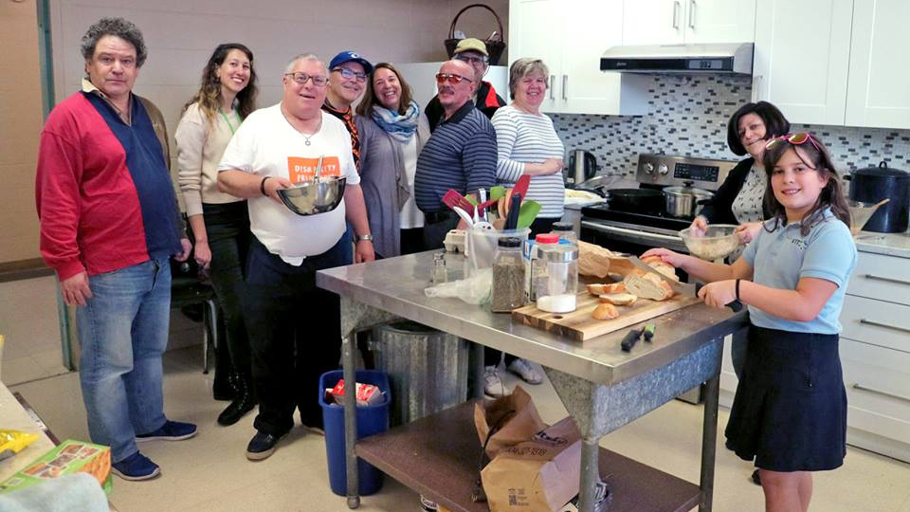
Specifically, we will identify at least 25 teams to participate, with each team consisting of an individual who will become a Network Facilitator and a family with an individual with disabilities who wants to develop his or her natural support networks

Slide 12
Working together with Planned Lifetime Advocacy Network and Plan Institute, over the next 24 months, Full Circle participants will:
Participate in 3 in-person workshops held throughout North Carolina
Complete an online course “Personal Support Network Facilitation”
Have access to tools and resource needed to develop a network
Receive ongoing Mentoring and Support
Provide updates and information will contribute to developmental learning and evaluation
Share stories and learning through social media

Slide 13
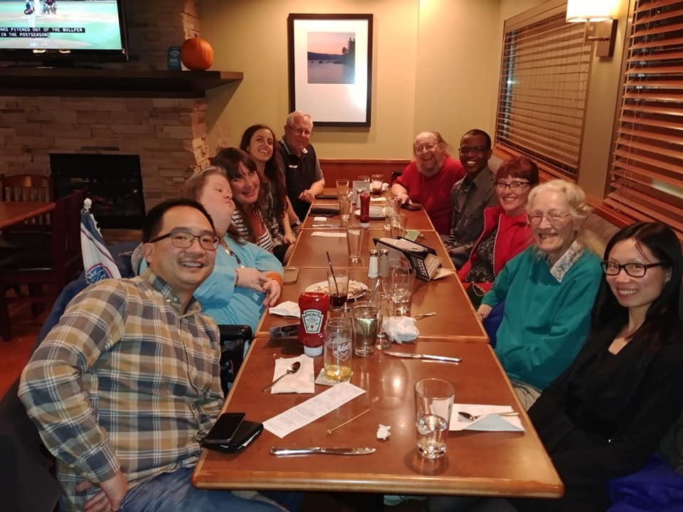
This will result in at least 25 success stories, and the 25 Network Facilitators will be able to repeat the process with more families and individuals with disabilities.
Full Circle will also develop a specialized Training Guide to be shared across North Carolina that would explain how natural supports can form, and the benefits of creating opportunities for natural supports to develop in the lives of individuals with disabilities.

Slide 14
“Every single person has capacities, abilities and gifts. Living a good life depends on whether those capacities can be used, abilities expressed and gifts given. If they are, the person will be valued, feel powerful and well-connected to the people around them. And the community around the person will be more powerful because of the contribution the person is making.”
- John McKnight, Asset-Based Community Development

Slide 15
Upcoming Events
Community Conversations
November 14th
1pm to 4pm
Christmount Conference Center
Black Mountain
November 16th
9am to noon
O’Berry Center
Goldsboro
We still have room so sign up at firstwnc.org/fullcircle

Slide 16
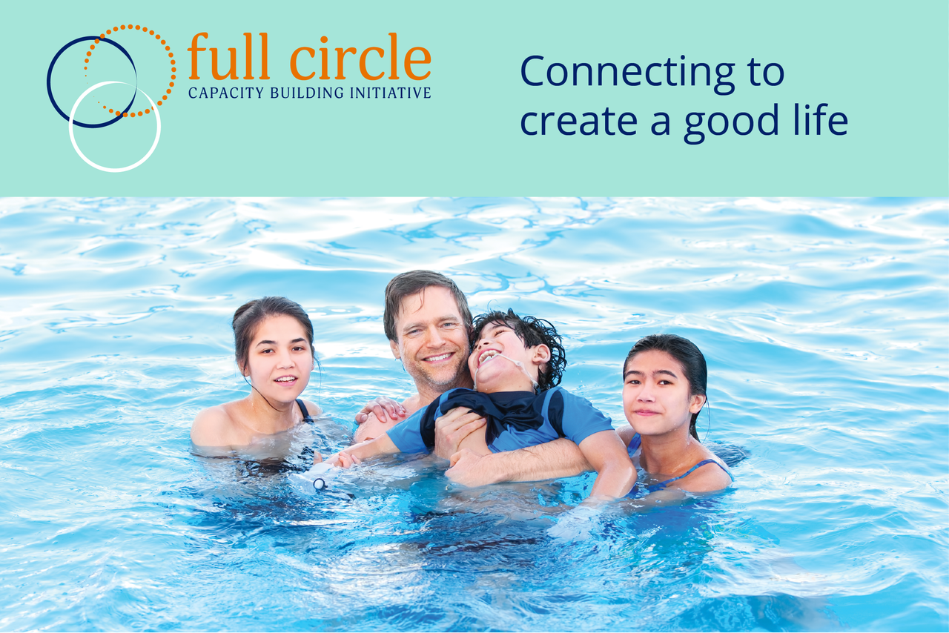

Slide 17
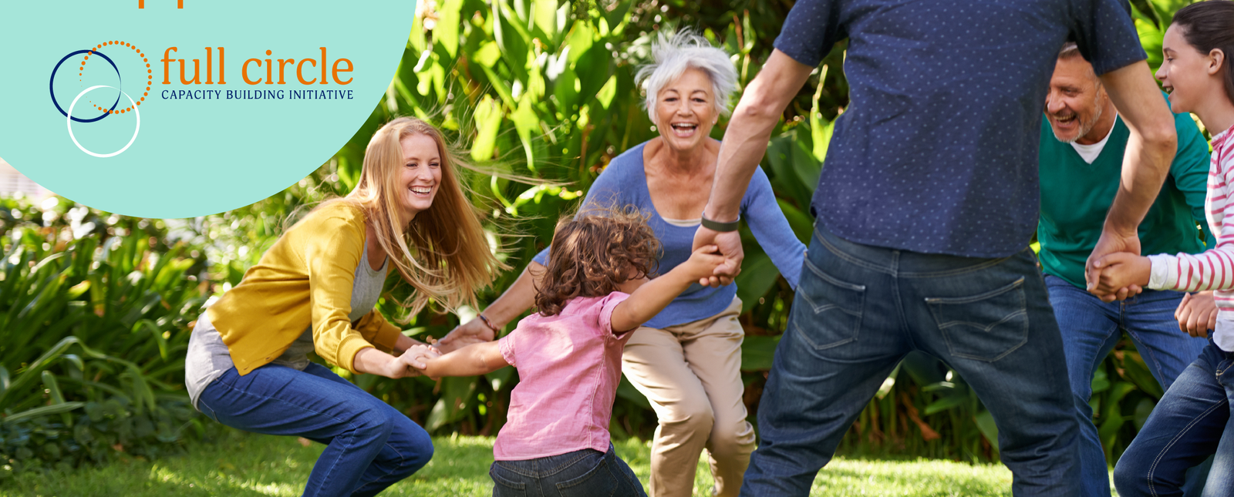
Thank you to the NCCDD for funding this Initiative!

Slide 18
Contact www.firstwnc.org/fullcircle
Janet Price-Ferrell
janet@firstwnc.org
Rebecca Pauls
rpauls@plan.ca

