Slide 1



Research Findings and Policy Solutions
to Address the North Carolina Registry of Unmet Needs
Christina Dupuch, MSW, Sarah Pfau, JD, MPH, Michelle S. Franklin, PhD, FNP, PMHNP
September 9th, 2021

Slide 2
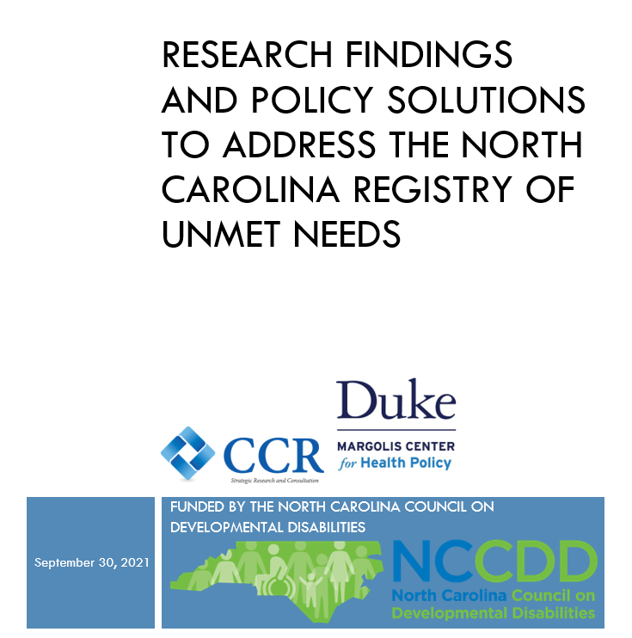
Final Report Coming to the NCCDD Website in October!

Slide 3
Today’s Conversation
Opening Remarks & Introductions
Scope of Work: NCCDD Registry of Unmet Needs Project
LME/MCO Survey & Findings
NC Stakeholder Listening Sessions: Considerations/Concerns /Strategies
State Interviews & Findings
Policy Recommendations
Questions/Comments
Next Steps

Slide 4
NCCDD Project Description
Investigate and report on the current processes and administration of the waivers and I/DD state-funded services by the State and LME/MCOs,
Explore the needs of individuals on the RUN and the processes for determining such needs,
Explore the funding and processes for individuals on the RUN who are provided new waivers or services, and any processes for individuals on the RUN experiencing emergency needs.
Investigate and report on historical funding of Medicaid waivers, particularly new waiver funding for those on the RUN from 2010 to the present.
Investigate, evaluate, and report on national and state strategies to reduce the number of people on the RUN and to meet their needs,

Slide 5
NCCDD Project Description
Investigate, evaluate, and report on systemic efforts that may impact the RUN, including Medicaid Transformation; state Olmstead planning; and legislative, judicial, and agency efforts.
Facilitate four or more “Conversations with the Council” on the potential strategies to impact the RUN with:
  State Medicaid, DMH/DD/SAS, and agency leaders;
  Advocacy groups, advocates, self-advocates, and families;
  LME/MCOs; and
  Designated stakeholders.
Connect the Council Executive Director, staff, and Council Members with key agency and stakeholder leaders.

Slide 6
LME/MCO Surveys
Alliance
Cardinal
Eastpoint
Partners
Sandhills
Trillium
Vaya

Slide 7
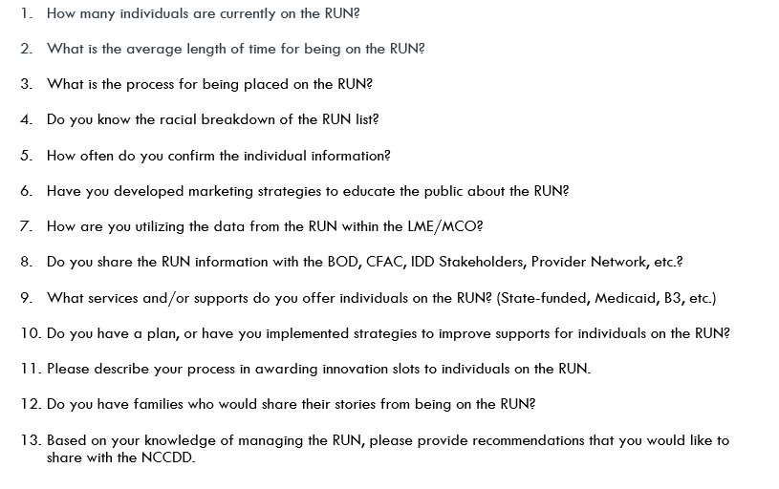
Appendix B: North Carolina LME/MCO Survey Questions

Slide 8
LME/MCO Survey Findings
RUNs among all seven LME/MCOs
January 2021 = 15,187
December 2019 = 14,295
6% increase Dec 2019 to Jan. 2021
Average number per region = 2,169
Smallest waiting list: Eastpointe = 597
Largest waiting list: Alliance Health = 3996
Wait times
NC RUN wait time: 5 - 15 years
Wait time varies by slot type & by county
Slot Assignments
First come, first served basis
  Then on per capita basis within catchment area counties

Slide 9
LME/MCO Survey Findings
The RUN is not managed in a standardized way
LME/MCOs neither manage their RUN lists nor communicate with RUN enrollees consistently.
Some LME/MCOs cannot report demographic or other trends within their RUN.
Other LME/MCOs monitor RUN enrollees’ age, race, ethnicity, and county of residence.
3 of 7 LME/MCOs do not track the race and ethnicity of individuals who are on the RUN.
1 LME/MCO collects the demographic information on applications but does not analyze or report it.
3 LME/MCOs analyze the race and ethnicity of their RUN population.
1 LME/MCO, Vaya Health, provided its RUN race and ethnicity data with survey responses.

Slide 10
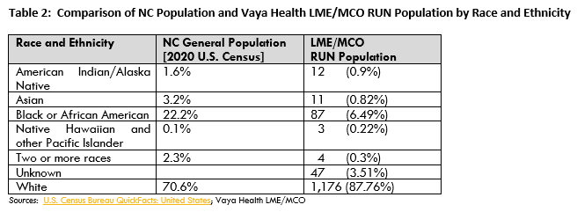
LME/MCO RUN Population Race & Ethnicity
Statewide collection and analysis of these data across all LME/MCOs are warranted to ensure that systemic biases are not posing barriers to access for any race or ethnicity.

Slide 11
LME/MCOs that collect and analyze their RUN data implement the following strategies to better serve their members:
In-lieu-of Medicaid services and definitions to assist beneficiaries while they are on the RUN
State-funded services and definitions to assist beneficiaries while they are on the RUN
In-reach efforts
Children with complex needs services
Behavioral health and substance use disorder services
Provider contracting and quality management activities
Increased care coordinators efforts to assist with educating and linking members to the RUN or services available
Some LME/MCOs have care coordinators dedicated to RUN enrollees
Engage community-based resources to connect individuals on the RUN with services that are available
Some LME/MCOs assess the service needs of individuals on the RUN as often as quarterly

Slide 12
LME/MCO Policy Recommendations
Greater regulation of the RUN process either within the Waiver (which has the force and effect of administrative rule pursuant to NC Statutes) or within the LME/MCO-DHHS contracts;
Executive Leadership meetings to facilitate standardized RUN oversight and management;
3) NC General Assembly appropriations for additional Innovations Waiver slots;
4) NC General Assembly and Centers of Medicaid/Medicare Services (CMS) authorization and appropriations for broader Medicaid supports, including medical and non-medical drivers of health, and in lieu of services for individuals on the RUN;
5) A Statewide, DHHS-operated RUN database to increase administrative efficiency and accuracy and to centralize the oversight of slots;

Slide 13
LME/MCO Policy Recommendations
6) Authorization to fill vacant slots in real time versus at the beginning of a new budget year;
7) Consumer and family education about the RUN and the Innovations Waiver and assistance with referrals to other community living and support services available;
8) More staff designated to work with RUN applicants and to evaluate applicants for the Social Determinants of Health (Food Insecurities, Transportation, Housing and Personal Violence)
9) A meaningful feedback loop between each LME/MCO (or the State, if operations become centralized) and each individual on the RUN to include annually, but preferably quarterly, communication regarding RUN status.

Slide 14
NC Stakeholder
Listening Sessions

Slide 15
IDD Stakeholder Conversations
NCCDD Members
State CFAC
DD Consortium
Olmstead: Community Capacity Committee
NC Providers Council – IDD Committee
NC Innovations Action Waiver Team
Money Follows the Person Stakeholder Committee
Cardinal Innovations Healthcare IDD Stakeholder Group

Slide 16
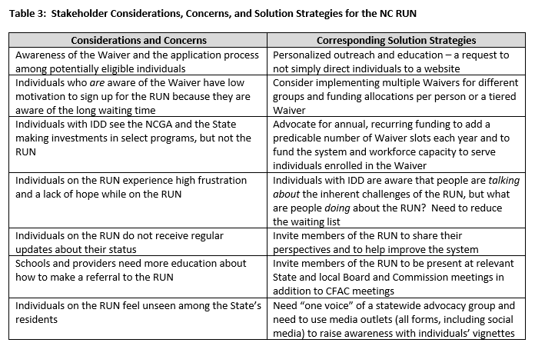

Slide 17
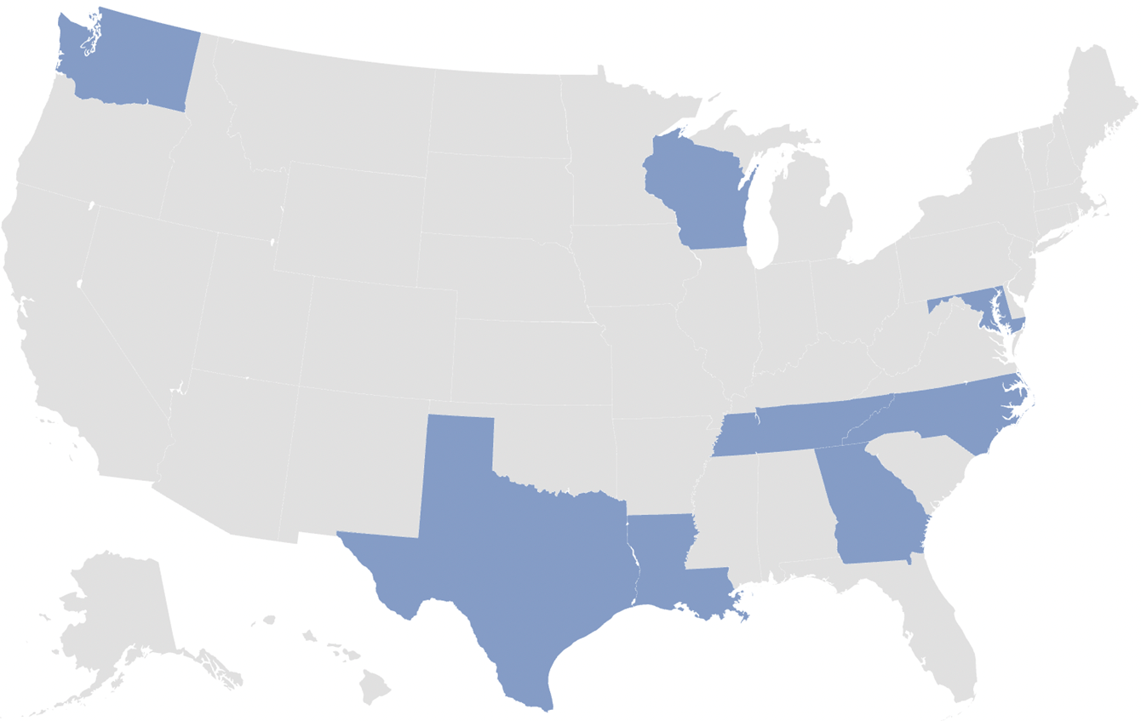
State Interviews
Purpose
Identify effective strategies for improving access to IDD Waiver Slots by examining how states have:
Designed and adapted their IDD waiver systems
Shortened or eliminated their waiting lists
Addressed unmet needs and inequities
States Interviewed
North Carolina
Georgia
Louisiana
Maryland
Tennessee
Texas
Washington
Wisconsin

Slide 18
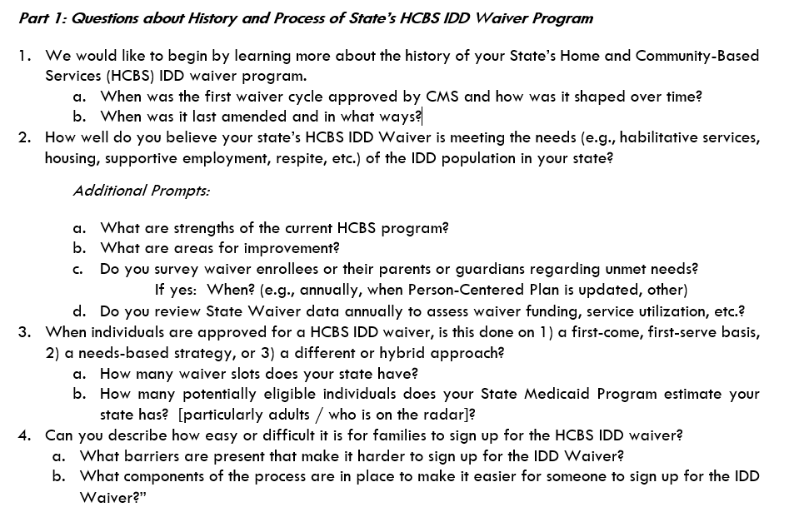
Appendix A: State Interview Questions

Slide 19
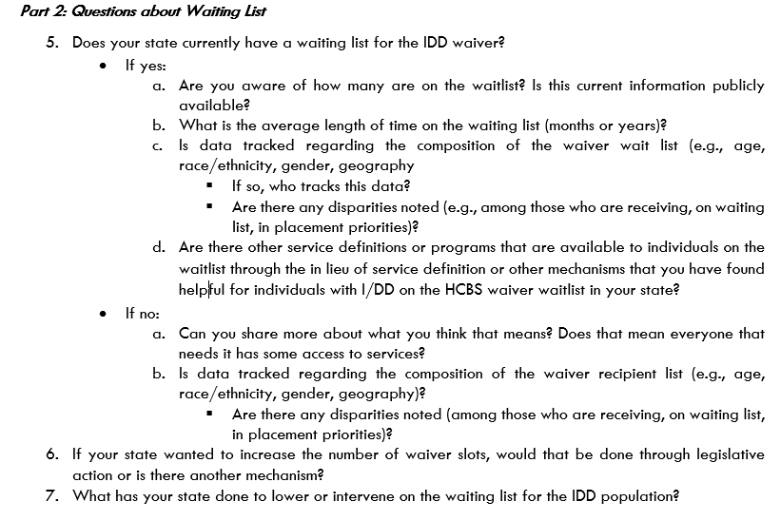
Appendix A: State Interview Questions

Slide 20
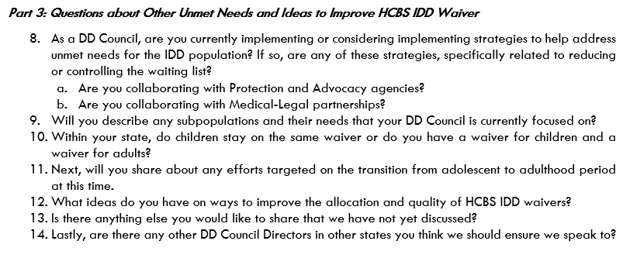
Appendix A: State Interview Questions

Slide 21
State Survey Results
Outcome | North Carolina | Average (range) | # of States Analyzed
# of IDD Waivers | 1 | 3.6 (1-10) | 8
# of Waiver Slots | 13,138 | 19,814 (10k-60k) | 6
# on Waiting List | ~15,000 | 27,155 (0-159k) | 8
Waiting List Time (Years) | ~10 | 9.1 (0-15) | 5

Slide 22
States with Shortened or Eliminated Waiting Lists
Louisiana
4 waivers currently; applying for one, 4-tiered waiver
2015: 40,000 waiting (10-14 years)
2021: now 13,200 waiting
Key investment
Wisconsin
Statewide managed care with 4 statewide plans
Robust benefits
No waiting list as of Feb. 2021
Entitlement

Slide 23
State Strategies for Reducing Or Eliminating Waiting Lists
Shared Strategies (2 or more states)
Unique Strategies
Advocate for recurring, annual State legislative appropriations
Maintain a rapport with a legislative Champion
Maximize access to information and non-waiver services
Tier waivers by service needs
Use statutorily dedicated funding (LA)
Use grassroots advocacy to make Waiver slots an entitlement under managed care (WI)
Train and fund Cultural Brokers to prevent or address systemic bias (MD)
Coordinate with other payors in the system (GA)
Make a documentary film to feature waiting list stories (GA)

Slide 24
Conclusions

Slide 25
Policy Recommendations for
The North Carolina Innovations Waiver
Increase the number of Waiver slots so more individuals with IDD will be fully included, respected, valued, and supported in their communities.
Increase workforce capacity and wages to ensure adequate support for existing and new Waiver slots.
Centralize the Registry of Unmet Needs database within NC DHHS to ensure accurate data and timely and periodic (quarterly) notifications to beneficiaries on the RUN.
Offer an online portal via NC DHHS (or consider amending the Enrollment Broker contract) for beneficiaries to read about, self-refer, and apply for the RUN.
Institute and centralize a RUN enrollment telephone line.
Collaborate with the North Carolina Institute of Medicine (NCIOM) on a year-long Task Force and final report that would yield recommendations to the North Carolina General Assembly.
  The task force could include representatives from the LME/MCOs (future Tailored Plans), the State Medicaid agency, consumers and their families, Disability Rights North Carolina, care management agencies, and vendors who might have a role in State operations.
Develop educational content for potentially eligible individuals and consider Limited English Proficiency needs and outreach strategies for Historically Marginalized Populations within both urban and rural communities.

Slide 26
Policy Recommendations for
The North Carolina Innovations Waiver
Work with stakeholders who can lobby to get the North Carolina General Assembly to support new slots annually with recurring funding.
Institute annual reassessments of individuals on the RUN to ensure that their service needs are accurately documented and to facilitate any care management that may help them find non-Waiver services for which they are eligible.
Expand the scope of data collected from RUN applicants to track the number of individuals on the RUN who are using one or more other services each month, and the service lines that they are using.
Consider moving North Carolina away from a first come, first served RUN model and shifting to a needs-based placement with tiered enrollment and annual Innovations Waiver slot budget levels like those proposed in the 2021 Session Senate Budget bill. It could be helpful for LME/MCOs (future Tailored Plans) to track the numbers of individuals on the RUN who are receiving one or more other services per month. Those data, in addition to initial and periodic assessments, could inform the critical levels of service need on the RUN and determine how the list could be more strategically managed.

Slide 27
Questions/Comments:
Please send comments or suggestions by Friday September 17th to: info@nccdd.org
Next Steps

Slide 28

Thank you for the opportunity to assist the NCCDD in discovering the ways to move the system forward based on the strengths & challenges of ALL North Carolinians.
It has been our pleasure to serve you.

